Slide 1

A PROJECT ON
“[AI-Based Interior Design Automation Using Generative Models and Real-Time Sensing]”
Presented by
  Mr. Sujit Nirmal Roll No. [BE- BEBD22605]
  Mr. Soham Gulhane Roll No. [BE- BEBD22648]
  Mr. Swarup Mandhare Roll No. [BE- BEBD22643]
  Ms. Suhani Yadav Roll No. [BE- BEBD22577]
Department of Artificial Intelligence and Data Science
Dr. D. Y. Patil Institute of Engineering, Management &
Research, Akurdi, Pune-44
Academic Year 2025-26
B.E. SEM I

Slide 2
Outlines:
Introduction to the Domain
Motivation
Problem Statement
Objective
Conclusion

Slide 3
Introduction To The Domain:
Interior design is the process of planning and decorating indoor spaces to improve their functionality and appearance. Traditionally, it involves manual sketching, measuring, and selecting furniture and colors.
AI in interior design uses technologies like computer vision, 3D modeling, generative AI, and decision-making models (like MDP) to automate layout planning, personalize designs, and improve user satisfaction — making the design process faster, smarter, and more sustainable for homes, offices, and commercial spaces.

Slide 4
Motivation:
Manual interior design is slow and effort-intensive
Generative AI can boost creativity and offer multiple design options
AI enables real-time sensing and layout planning from simple inputs
Need for eco-friendly and sustainable design choices
Growing demand for faster, smarter, and personalized design solutions

Slide 5
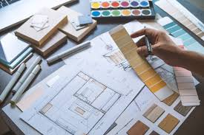
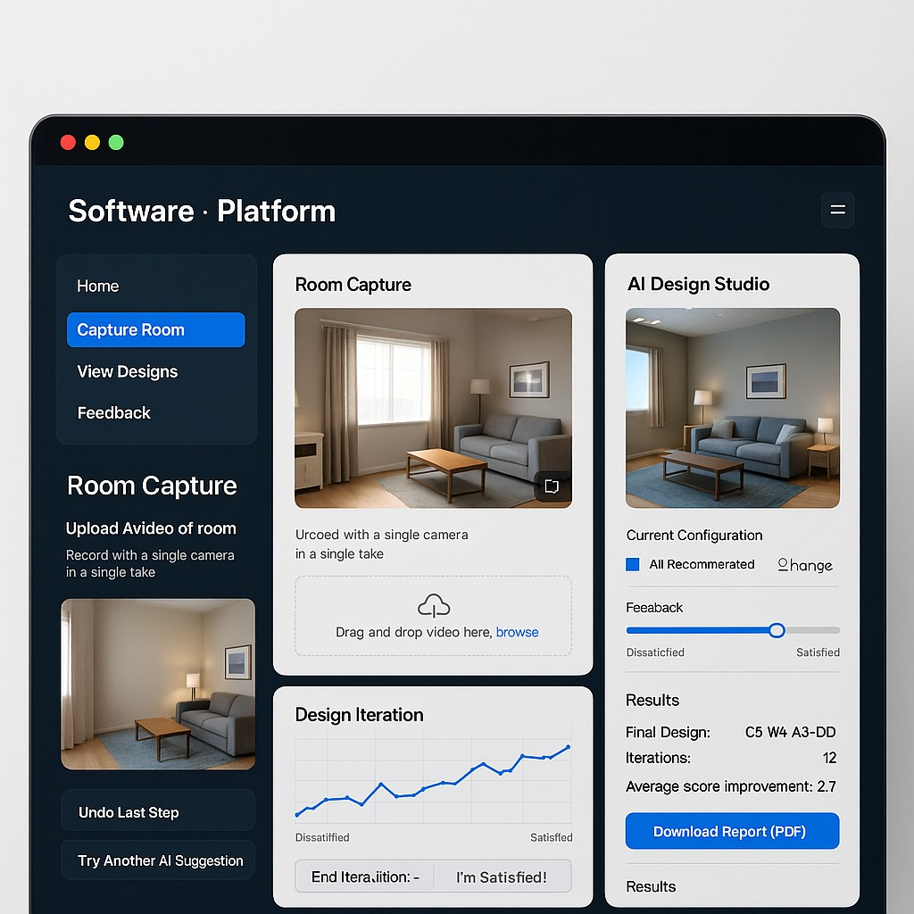
Problem Statement:
Many people struggle to visualize multiple design options without physically placing furniture and decor in the space. This process uses time and resources, as clients have to physically set up and take down multiple design configurations and also it is a manual process , so we cant recursively implement on large scale .

Slide 6
Objective:
To develop an AI-based system that automates interior designing :
Understanding room layouts using monocular video input
Generating a 3D building model with spatial details.
Using a Markov Decision Process (MDP) to make design decisions
Helping users manage costs with real-time shopping suggestions and price tracking .

Slide 7
Conclusion:
AI is transforming the interior design process by making it faster, smarter, and more user-friendly. Through tools like Generative AI, Markov Decision Process, and real-time sensors, design decisions can be automated, layouts can be generated from simple inputs, and user satisfaction can be improved with intelligent feedback.

Slide 8
Thank You!

Slide 9
Q&A……

